Slide 1
NAT & PAT
Course Code: CSC 3116
Course Title: Computer Networks
Dept. of Computer Science
Faculty of Science and Technology
Lecturer No: | 9 | Week No: | 9 | Semester: | Fall2021-22

Slide 2
Lecture Outline
1. Private Network
2. NAT
3. NAT Operation
4. Pooling of IP Address
5. PAT
6. Load Balancing of Servers
7. Advantage/Disadvantage

Slide 3
Private Network
Private IP network is an IP network that is not directly connected to the Internet
IP addresses in a private network can be assigned arbitrarily.
  Not registered and not guaranteed to be globally unique
Generally, private networks use addresses from the following experimental address ranges (non-routable addresses):
  10.0.0.0 – 10.255.255.255
  172.16.0.0 – 172.31.255.255
  192.168.0.0 – 192.168.255.255

Slide 4
Private Addresses

Slide 5
Network Address Translation (NAT)
A short term solution to the problem of the depletion of IP addresses
  Long term solution is IP v6
  CIDR (Classless InterDomain Routing ) is a possible short term solution
  NAT is another
NAT is a way to conserve IP addresses
  Can be used to hide a number of hosts behind a single IP address
  Uses private addresses:
    10.0.0.0-10.255.255.255,
    172.16.0.0-172.32.255.251 or
    192.168.0.0-192.168.255.255

Slide 6
Network Address Translation (NAT) (cont…)
NAT is a router function where IP addresses (and possibly port numbers) of IP datagrams are replaced at the boundary of a private network
NAT is a method that enables hosts on private networks to communicate with hosts on the Internet
NAT is run on routers that connect private networks to the public Internet, to replace the IP address-port pair of an IP packet with another IP address-port pair.

Slide 7
Basic Operation of NAT
NAT device has address translation table
One to one address translation

Slide 8
Pooling of IP Addresses
Scenario: Corporate network has many hosts but only a small number of public IP addresses
NAT solution:
  Corporate network is managed with a private address space
  NAT device, located at the boundary between the corporate network and the public Internet, manages a pool of public IP addresses
  When a host from the corporate network sends an IP datagram to a host in the public Internet, the NAT device picks a public IP address from the address pool, and binds this address to the private address of the host

Slide 9
Pooling of IP Addresses (cont…)

Slide 10
Supporting Migration between
Network Service Providers
Scenario: In CIDR, the IP addresses in a corporate network are obtained from the service provider. Changing the service provider requires changing all IP addresses in the network.
NAT solution:
  Assign private addresses to the hosts of the corporate network
  NAT device has static address translation entries which bind the private address of a host to the public address.
  Migration to a new network service provider merely requires an update of the NAT device. The migration is not noticeable to the hosts on the network.

Slide 11
Supporting Migration between network service Providers (cont…)

Slide 12
IP Masquerading
Also called: Network address and port translation (NAPT), port address translation (PAT).
Scenario: Single public IP address is mapped to multiple hosts in a private network.
NAT solution:
  Assign private addresses to the hosts of the corporate network
  NAT device modifies the port numbers for outgoing traffic

Slide 13
IP Masquerading (cont…)

Slide 14
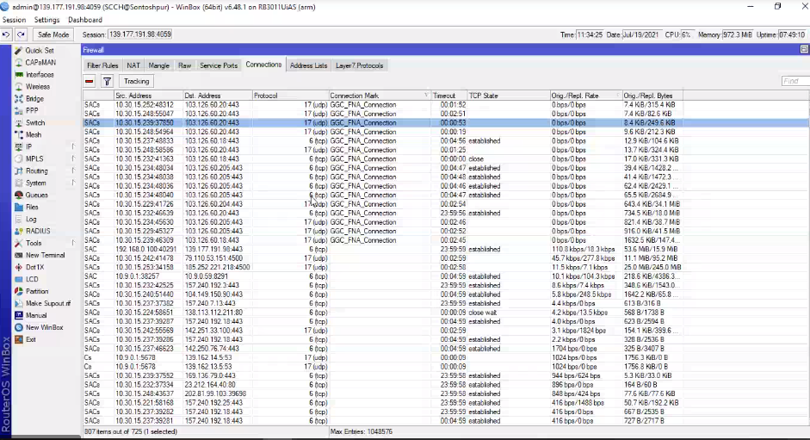

Slide 15
Load Balancing of Servers
Scenario: Balance the load on a set of identical servers, which are accessible from a single IP address
NAT solution:
  Here, the servers are assigned private addresses
  NAT device acts as a proxy for requests to the server from the public network
  The NAT device changes the destination IP address of arriving packets to one of the private addresses for a server
  A sensible strategy for balancing the load of the servers is to assign the addresses of the servers in a round-robin fashion.

Slide 16
Load Balancing of Servers (cont…)

Slide 17
Concerns about NAT
Performance:
  Modifying the IP header by changing the IP address requires that NAT boxes recalculate the IP header checksum
  Modifying port number requires that NAT boxes recalculate TCP checksum
Fragmentation
  Care must be taken that a datagram that is fragmented before it reaches the NAT device, is not assigned a different IP address or different port numbers for each of the fragments.

Slide 18
Advantage
Advantages of NAT
• The main advantage of NAT (Network Address Translation) is that it can prevent the depletion of IPv4 addresses.
• NAT (Network Address Translation) can provide an additional layer of security by making the original source and destination addresses hidden.
• NAT (Network Address Translation) provides increased flexibility when connecting to the public Internet.
• NAT (Network Address Translation) allows to use your own private IPv4 addressing system and prevent the internal address changes if you change the service provider.

Slide 19
Disadvantage
Disadvantages of NAT
• NAT (Network Address Translation) is a processor and memory resource consuming technology, since NAT (Network Address Translation) need to translate IPv4 addresses for all incoming and outgoing IPv4 datagrams and to keep the translation details in memory.
• NAT (Network Address Translation) may cause delay in IPv4 communication.
• NAT (Network Address Translation) cause loss of end-device to end-device IP traceability

Slide 20
References
  Data Communications and Networking, B. A. Forouzan, McGraw-Hill, Inc., Fourth Edition, 2007, USA.
  https://www.geeksforgeeks.org/basics-computer-networking/
  https://www.tutorialspoint.com/computer_fundamentals/computer_networking.htm

Slide 21
Books
  Data Communications and Networking, B. A. Forouzan, McGraw-Hill, Inc., Fourth Edition, 2007, USA.
  Computer Networking: A Top-Down Approach, J. F., Kurose, K. W. Ross, Pearson Education, Inc., Sixth Edition, USA.
  Official Cert Guide CCNA 200-301 , vol. 1, W. Odom, Cisco Press, First Edition, 2019, USA.
  CCNA Routing and Switching, T. Lammle, John Wily & Sons, Second Edition, 2016, USA.
  TCP/IP Protocol Suite, B. A. Forouzan, McGraw-Hill, Inc., Fourth Edition, 2009, USA.
  Data and Computer Communication, W. Stallings, Pearson Education, Inc., 10th Education, 2013, USA.

